Slide 1
Quality
UNIT 3

Slide 2
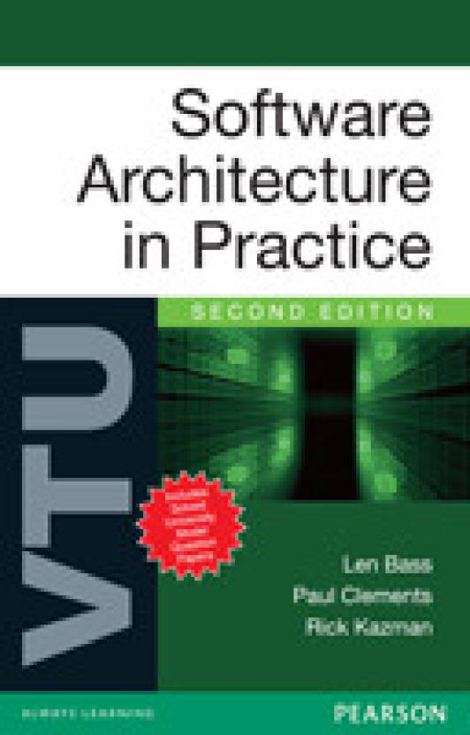
Reference
sites.google.com/view/snandagopalan

Slide 3
Agenda Quality…..
Functionality and Architecture
Architecture and quality attributes
System quality attributes
Quality attribute scenarios in practice
Other system quality attributes
Business qualities
Architecture qualities

Slide 4
Agenda Achieving Quality…..
Introducing tactics
Availability tactics
Modifiability tactics
Performance tactics
Security tactics
Testability tactics
Usability tactics
Relationship of tactics to architectural patterns

Slide 5
Introduction
As we have seen in the Architecture Business Cycle, business considerations determine qualities that must be accommodated in a system's architecture.
Functionality and other qualities are closely related.
The focus is how to express the qualities we want our architecture to provide to the systems.

Slide 6
Quality attributes means…
Quality attributes are the overall factors that affect run-time behavior, system design, and user experience.
They represent areas of concern that have the potential for application wide impact across layers and tiers.
Some of these attributes are related to the overall system design, while others are specific to run time, design time, or user centric issues.
The extent to which the application possesses a desired combination of quality attributes such as usability, performance, reliability, and security indicates the success of the design and the overall quality of the software application.

Slide 7
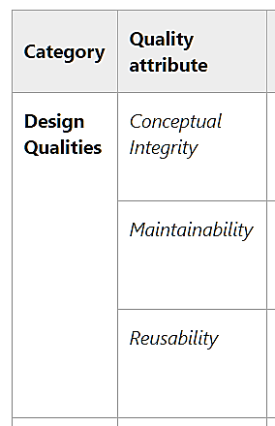
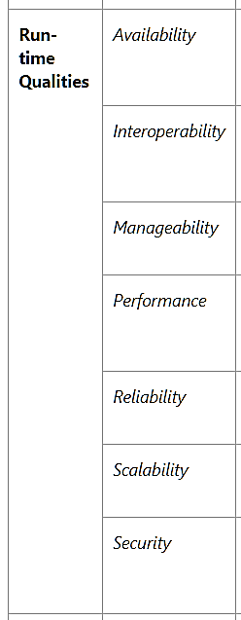
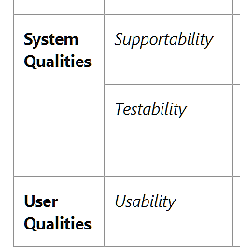
Common Quality attributes

Slide 8
Functionality and Architecture
Functionality and quality attributes are orthogonal
What is functionality?
It is the ability of the system to do the work for which it was intended
A task requires that many system's elements work in a coordinated manner to complete the job
Ex: masons, electricians, plumbers, painters, and carpenters all come together to cooperatively build a house.
Systems are frequently divided so that several people can cooperatively build them

Slide 9
Architecture and Quality Attributes
Achieving quality attributes must be considered throughout design, implementation, and deployment
Usability
This involves both architectural and nonarchitectural aspects.
The nonarchitectural aspects include making the user interface clear and easy to use.
Should you provide a radio button or a check box? What screen layout is most suitable?
Whether a system provides the user with the ability to cancel operations, to undo operations, or to re-use data previously entered - architectural

Slide 10
Architecture and Quality Attributes
Modifiability
how functionality is divided (architectural) and by coding techniques within a module (nonarchitectural).
A system is modifiable if changes involve the fewest possible number of distinct elements.
Performance
How much communication is necessary among components (architectural), partially on what functionality has been allocated to each component (architectural)
How shared resources are allocated (architectural), & choice of algorithms and its how they are coded (nonarchitectural).

Slide 11
Three Classes of Quality
Qualities of the system. availability, modifiability, performance, security, testability, and usability
Business qualities
time to market that are affected by the architecture.
conceptual integrity, that are about the architecture itself although they indirectly affect other qualities

Slide 12
System Quality Attributes
Issues
The definitions provided for an attribute are not operational. It is meaningless to say that a system will be modifiable. Every system is modifiable with respect to one set of changes and not modifiable with respect to another.
Is a system failure an aspect of availability, an aspect of security, or an aspect of usability? All three attribute communities would claim ownership of a system failure.
performance community – “events”
security community - "attacks“
availability community -"failures“
usability community -"user input”.
Solution - quality attribute scenarios as a means of characterizing quality attributes

Slide 13
QUALITY ATTRIBUTE SCENARIOS
A quality attribute scenario is a quality-attribute-specific requirement.
Source of stimulus. This is some entity (a human, a computer system, or any other actuator) that generated the stimulus.
Stimulus. The stimulus is a condition that needs to be considered when it arrives at a system.
Environment. The stimulus occurs within certain conditions. The system may be in an overload condition or may be running when the stimulus occurs, or some other condition may be true.
Artifact. Some artifact is stimulated. This may be the whole system or some pieces of it.
Response. The response is the activity undertaken after the arrival of the stimulus.
Response measure. When the response occurs, it should be measurable in some fashion so that the requirement can be tested.

Slide 14
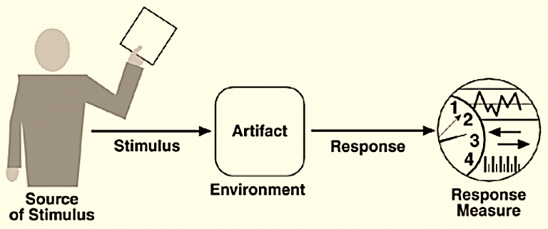
Contd.
Quality attribute parts

Slide 15
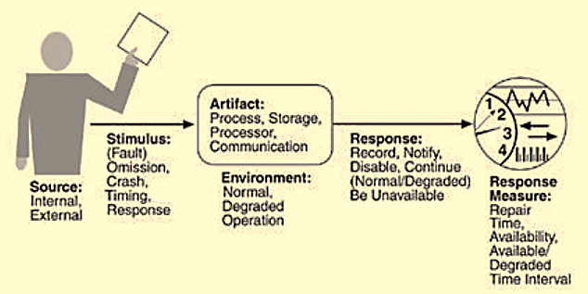
(a) Availability Scenario
Availability is concerned with system failure and its associated consequences.
Why system failure occurs? when the system no longer delivers a service consistent with its specification.
Such a failure is observable by the system's users—either humans or other systems.
Availability General Scenarios

Slide 16
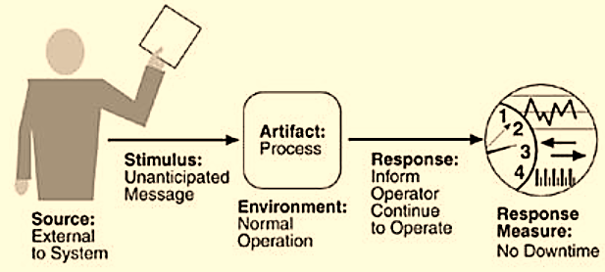
Example
Availability scenarios
Ex: while receiving an unanticipated external message.
Sample Availability Scenarios

Slide 17
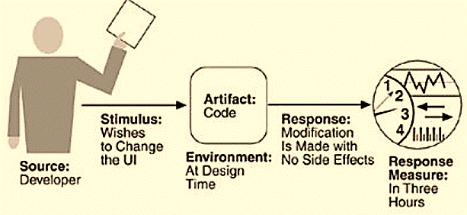
(b) Modifiability Scenario
A sample modifiability scenario: "A developer wishes to change the user interface to make a screen's background color blue. This change will be made to the code at design time. It will take less than three hours to make and test the change and no side effect changes will occur in the behavior."

Slide 18
Quality Attribute Scenarios in Practice
General scenarios provide a framework for generating a large number of generic, system-independent, quality-attribute-specific scenarios.
Each is potentially but not necessarily relevant to the system you are concerned with.
Example
General scenario: "A request arrives for a change in functionality, and the change must be made at a particular time within the development process within a specified period. "
Specific: "A request arrives to add support for a new browser to a Web-based system, and the change must be made within two weeks."

Slide 19
(1) Availability
Availability means- system failure and its associated consequences.
It occurs when the system no longer delivers a service consistent with its specification.
It is observable by the system's users—either humans or other systems.
How system failure is detected?
How frequently system failure may occur?
What happens when a failure occurs?
How long a system is allowed to be out of operation, when failures may occur safely?
How failures can be prevented, and
What kinds of notifications are required when a failure occurs?

Slide 20
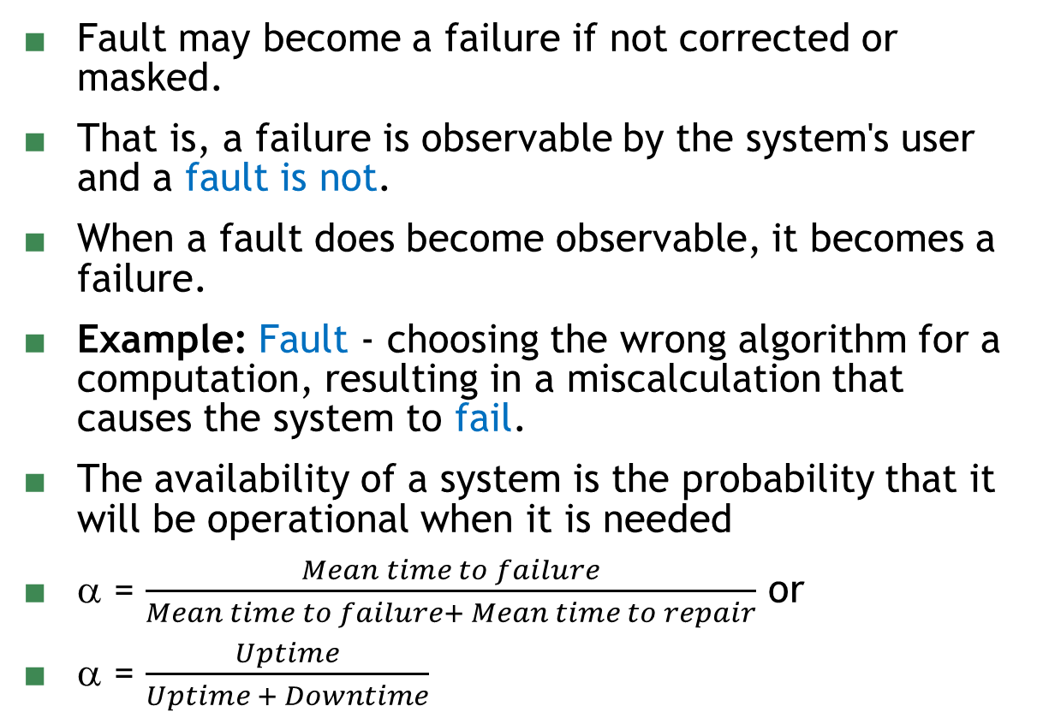
Failure Vs. Fault
Fault may become a failure if not corrected or masked.
That is, a failure is observable by the system's user and a fault is not.
When a fault does become observable, it becomes a failure.
Example: Fault - choosing the wrong algorithm for a computation, resulting in a miscalculation that causes the system to fail.
The availability of a system is the probability that it will be operational when it is needed
α = $\frac{Mean time to failure}{Mean time to failure+ Mean time to repair}$ or
α = $\frac{Uptime}{Uptime + Downtime}$

Slide 21
Availability General Scenarios
Source of stimulus. We differentiate between internal and external indications of faults or failure since the desired system response may be different. In our example, the unexpected message arrives from outside the system.
Stimulus. A fault of one of the following classes occurs.
omission. A component fails to respond to an input.
crash. The component repeatedly suffers omission faults.
timing. A component responds but the response is early or late.
response. A component responds with an incorrect value

Slide 22
General Scenario
Artifact. processor, communication channel, process, or storage.
Environment. The state of the system when the fault or failure occurs may also affect the desired system response.
Response. logging the failure, notifying selected users or other systems, switching to a degraded mode, etc.
Response measure. Specify availability percentage, or time to repair, times during which the system must be available, etc.

Slide 23
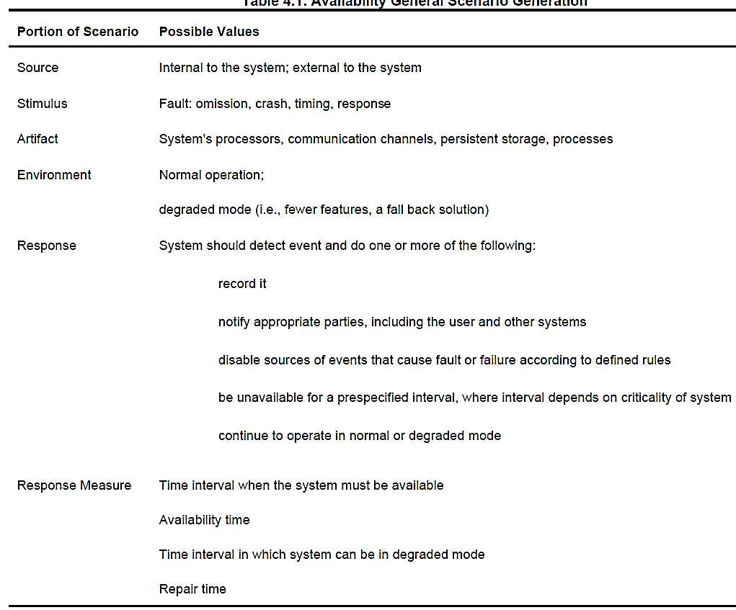
Table

Slide 24
MODIFIABILITY
Modifiability is about the cost of cha
What can change (the artifact)? - functions that the system computes, hardware, operating system, middleware, interoperability, protocols, performance, reliability, etc.
When is the change made and who makes it (the environment)? - to source code in the past, and which was tested and then deployed in a new release. Takes time, man hours, money….

Slide 25
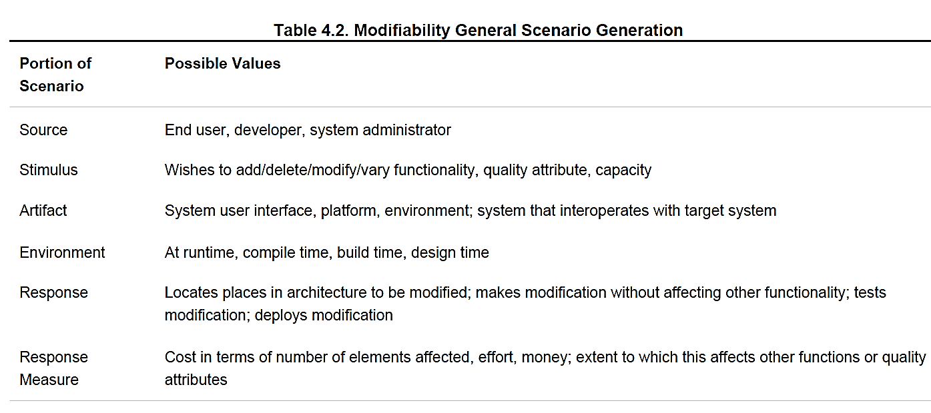
Modifiability General Scenarios

Slide 26
PERFORMANCE
Performance is about timing.
Events - interrupts, messages, requests from users, or the passage of time occur, and the system must respond to them.
How long it takes the system to respond when an event occurs?
Events can arrive from user requests, from other systems, or from within the system.
A Web-based financial services system gets events from its users - tens or hundreds of thousands.
From students of VTU (results) or banking s/w..

Slide 27
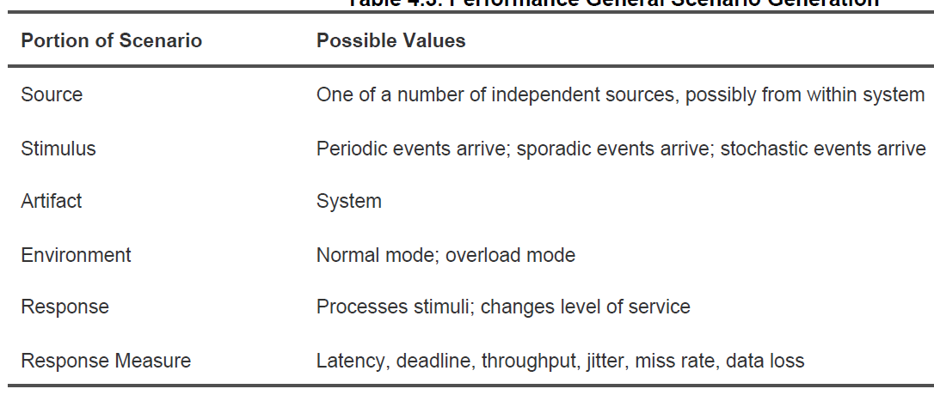
Performance General Scenarios

Slide 28
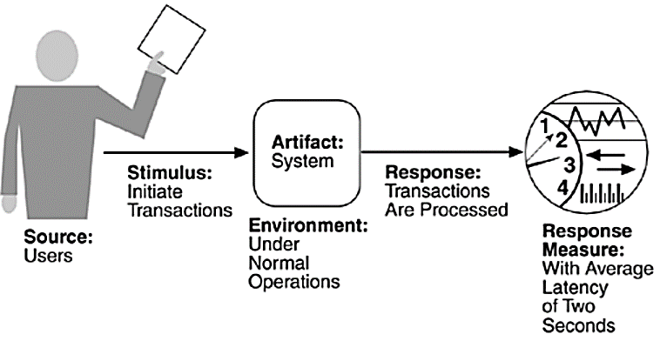
Sample Performance Scenarios
"Users initiate 1,000 transactions per minute stochastically under normal operations, and these transactions are processed with an average latency of two seconds."

Slide 29
SECURITY
Security is a measure of the system's ability to resist unauthorized usage while still providing its services to legitimate users.
An attempt to breach security is called an attack or threat and can take a number of forms.
Attempt to access data or services or to modify data, or it may be intended to deny services to legitimate users.
Ex: Aadhar card, Online Banking, Online payment systems, etc.

Slide 30
Characterization
Nonrepudiation - Tx cannot be denied. Ex: Online ordering.
Confidentiality - data or services are protected from unauthorized access. Ex: Hacker cannot access your income tax returns
Integrity - data or services are being delivered as intended. Ex: No change in IA marks as entered by the teacher.
Assurance - the parties to a transaction are who they belong to. Ex: when a customer sends a credit card number to an Internet merchant, the merchant is who the customer thinks they are.
Availability - system will be available for legitimate use. Ex: a denial-of-service attack won't prevent your ordering an item in online shopping.
Auditing - system tracks activities within it at levels sufficient to reconstruct them. Ex: if you transfer money out of one account to another account, in Switzerland, the system will maintain a record of that transfer.

Slide 31
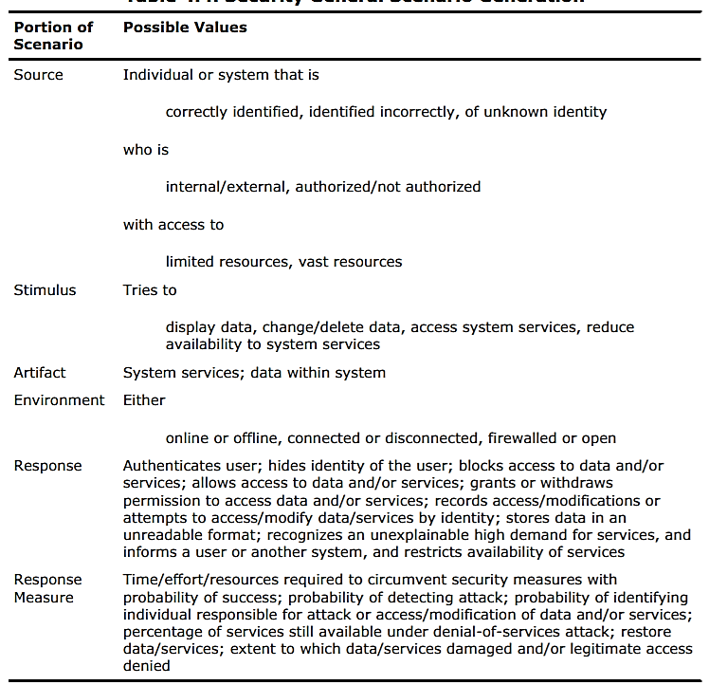
General Scenario generation

Slide 32
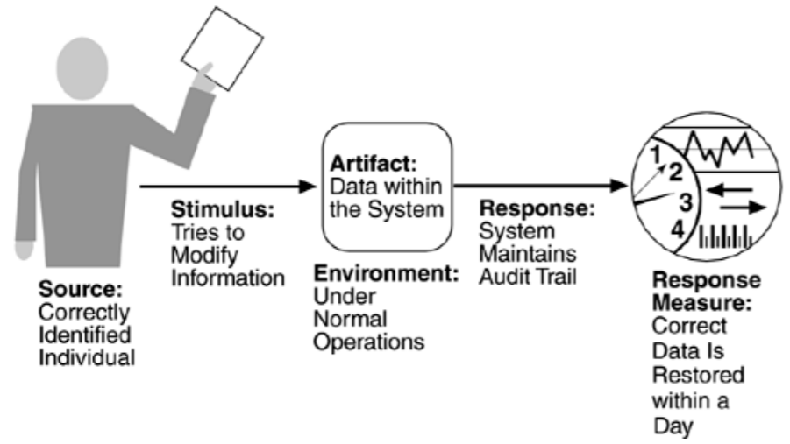
Sample security scenario

Slide 33
TESTABILITY
Software testability - ease with which software can be made to demonstrate its faults through execution.
At least 40% of the cost of developing well-engineered systems is taken up by testing.
control each component's internal state and inputs and then observe its outputs.
test harness - specialized software designed to exercise the software under test.
Testing is done by various developers, testers, verifiers, or users and is the last step of various parts of the software life cycle

Slide 34
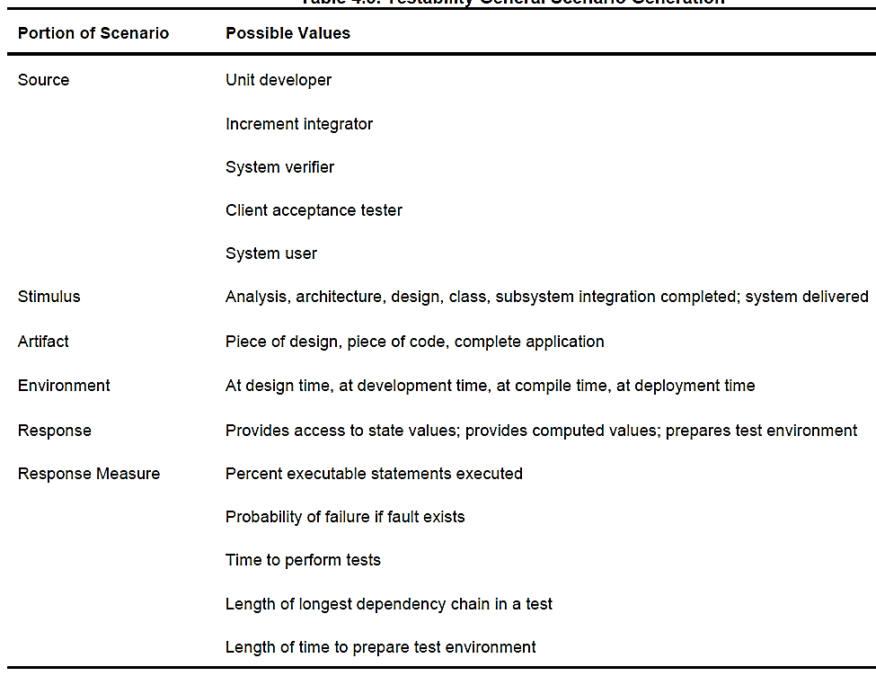
Testability General Scenarios

Slide 35
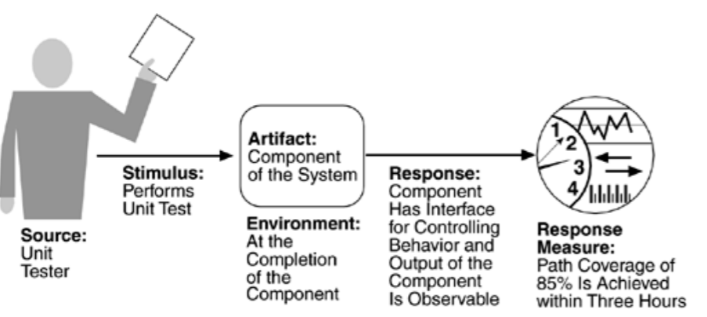
Sample Testability scenario

Slide 36
USABILITY
Usability - how easy it is for the user to accomplish a desired task and the kind of user support the system provides.
Learning system features. If the user is unfamiliar with a particular system, what can the system do to make the task of learning easier?
Using a system efficiently. What can the system do to make the user more efficient in its operation?
Minimizing the impact of errors. What can the system do so that a user error has minimal impact?
Adapting the system to user needs. How can the user (or the system itself) adapt to make the user's task easier?
Increasing confidence and satisfaction. What does the system do to give the user confidence that the correct action is being taken?

Slide 37
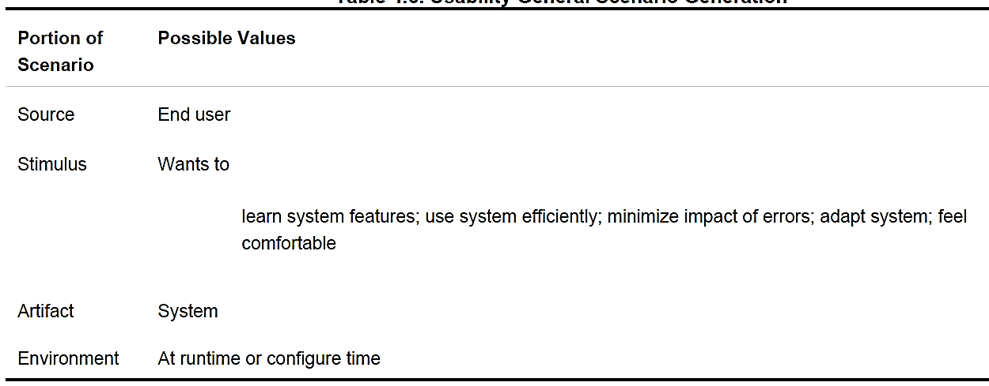
General usability Scenario

Slide 38
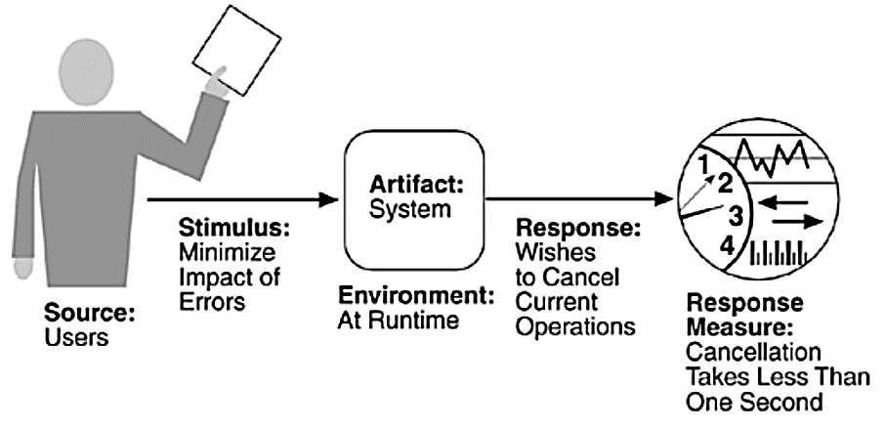
Sample
If you want to support the ability of a user to cancel an operation in progress, returning to the precise system state
in place before the operation was started, you need to plan for this capability in the architecture.

Slide 39
Other System Quality Attributes
Scalability
Portability
Interoperability
And so on…

Slide 40
Business Qualities
Time to market
Cost and benefit
Projected lifetime of the system
Targeted market
Rollout schedule
Integration with legacy systems

Slide 41
Architecture Qualities
Conceptual integrity is the underlying theme or vision that unifies the design of the system at all levels.
Correctness and completeness are essential for the architecture to allow for all of the system's requirements and runtime resource constraints to be met.
Buildability allows the system to be completed by the available team in a timely manner and to be open to certain changes as development progresses.

Slide 42
Summary

